Slide 1
Nuclear Fuels
Dr. Benjamin Beeler
Asst. Prof. in Nuclear Engineering
NE 201

Slide 2

Brief Bio/Background
Computational Nuclear Materials Scientist
Expertise in advanced nuclear fuels
Ph.D. in Nuclear Engineering from Georgia Tech
Previously a staff scientist at Idaho National Laboratory in Fuel Modeling and Simulation Group
Atomistic simulations: density functional theory and molecular dynamics

Slide 3
Fuel is the Heat Source
Fuel functions as a heat source, generating heat that is transferred to a coolant, which transfers heat through external loops, heat exchangers, etc., to run a generator

Slide 4
Fuel Considerations
Safety:
Stable and predictable behavior
No melting, no phase changes under transients
Uranium density
Mechanical integrity
Cladding interactions
Swelling and fission gas release
Operating temperatures

Slide 5
Fuel Types and Associated Reactor Types
UO2 – Light Water Reactors
MOX
ATF
UZr – Sodium Cooled Fast Reactors
UMo – Research Reactors
UC/UCO – High Temperature Gas Reactors
UN – Lead Cooled Fast Reactors

Slide 6
Fuel Types and Associated Reactor Types
UO2 – Light Water Reactors
MOX
ATF
UZr – Sodium Cooled Fast Reactors
UMo – Research Reactors
UC/UCO – High Temperature Gas Reactors
UN – Lead Cooled Fast Reactors

Slide 7
Uranium Dioxide (UO2)
Reference fuel for nuclear power industry
Single phase, fluorite structure
Fabrication via sintering UO2 powder into pellets
Water coolant
Pellets are stacked inside Zircaloy cladding tubes

Slide 8
UO2
Good!
Very high melting point, about 2800 C
Maintains a stable fluorite phase up to melting
Very compatible with Zircaloy clad (no interaction zones forming/no FCCI)
Relative stability in water
Reasonably radiation resistant
no amorphization
Can incorporate a large number of fission products as substitutional defects

Slide 9
UO2
Bad!
Brittle
thermal stress fractures, fragmentation
Poor thermal conductivity
Properties very sensitive to stoichiometry
Limited linear heating rates
Non-negligible thermal expansion/swelling

Slide 10
UO2
Critical Phenomena
Thermal conductivity (and degradation)
Fission gas release, leading to pressure increase inside the cladding
Fuel fragmentation and relocation under transients
Bambooing creating stress concentrations
All 98 operational reactors in US utilize UO2

Slide 11
UO2-mixed oxides
Can be combined with PuO2 for a mixed oxide (MOX) fuel for use in fast reactors
Allows to burn excess weapons grad plutonium
About 30 reactors in Europe currently utilize a partial MOX core
Similar behavior to UO2, but different neutronics, fission gas release, thermal conductivity, etc.
Less common is inclusion of minor actinides in MOX to burn waste

Slide 12
Accident Tolerant Fuel/Advanced Technology Fuel
Kept the acronym, changed the concept
USi fuels (U3Si2)
Higher thermal conductivity, higher uranium density
Cr-doped UO2
Larger grain size, reduced fission gas release
Coatings or alternate claddings – FeCrAl or SiC
Improved radiation resistance, corrosion resistance, etc.

Slide 13
Fuel Types and Associated Reactor Types
UO2 – Light Water Reactors
MOX and USi
UZr – Sodium Cooled Fast Reactors
UMo – Research Reactors
UC/UCO – High Temperature Gas Reactors
UN – Lead Cooled Fast Reactors

Slide 14
UZr
Utilized in sodium cooled fast reactors (SFRs)
EBR I, EBR II
Varied crystal structure and compositional environment
Easily alloyed with Pu, minor actinides (MA)
Can function as a breeder/burner fuel
Sodium coolant
Fe-based cladding

Slide 15
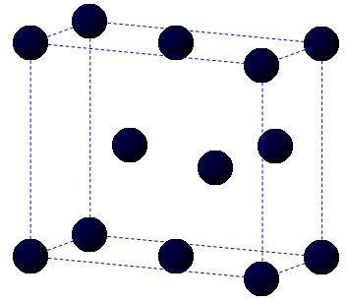
UZr
Alloy metallic U with Zr to increase the melting point and to stabilize the high temperature body-centered cubic phase
Interesting phenomena
30-50% swelling
Constituent redistribution
Alpha tearing
FCCI

Slide 16
UZr
Good!
High thermal conductivity
Stability to high burnups (> 20%)
Flexible composition
Inherent safety- negative reactivity feedback
Good compatibility with Na coolant

Slide 17
UZr
Bad!
Low melting point
Dramatic fuel swelling that must be accounted for
Incredibly complex microstructures/unpredictable behavior
Fuel-Clad Chemical Interaction
Very easily oxidized

Slide 18
Fuel Types and Associated Reactor Types
UO2 – Light Water Reactors
MOX and USi
UZr – Sodium Cooled Fast Reactors
UMo – Research Reactors
UC/UCO – High Temperature Gas Reactors
UN – Lead Cooled Fast Reactors

Slide 19

UMo
New fuel being qualified for research reactors
Fuel foil, with Zr diffusion barrier, Al cladding
Will be utilized in ATR, NBSR, MITR, MURR

Slide 20
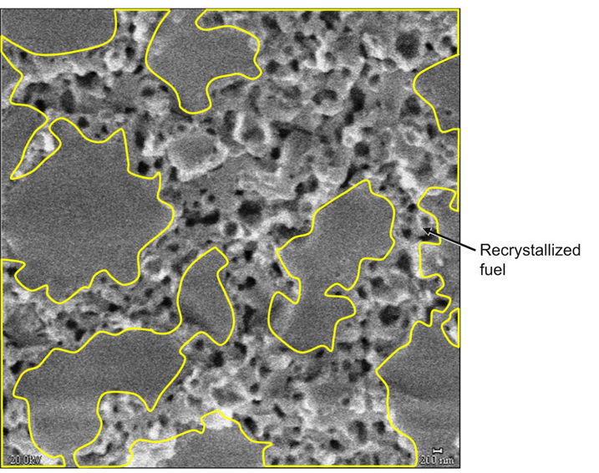
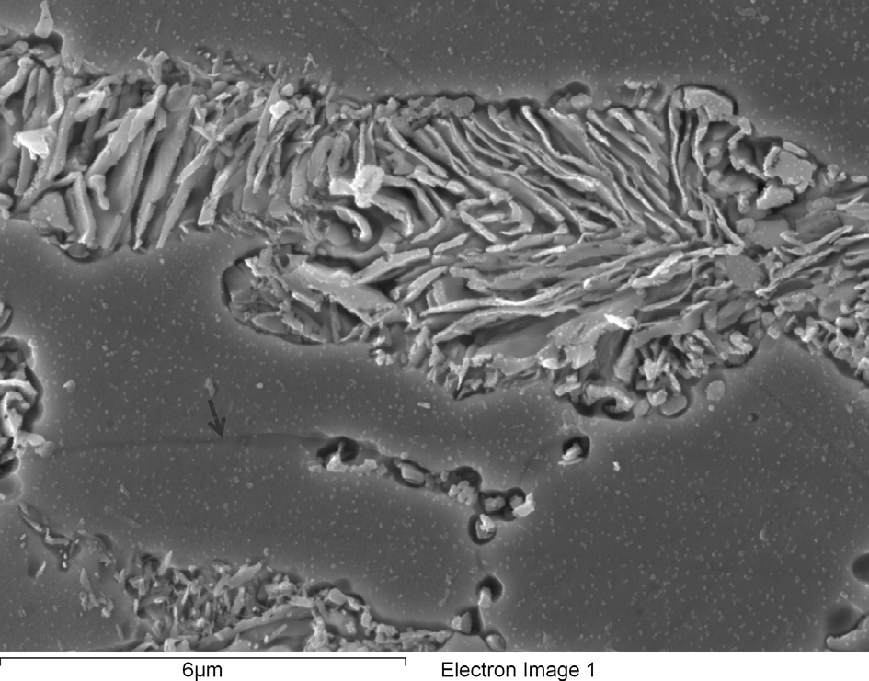
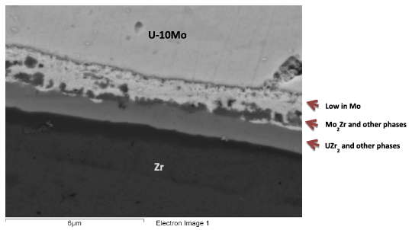
UMo
Decomposition
Fission Gas Superlattice
Recystallization
Interdiffusion region
Carbides

Slide 21
Fuel Types and Associated Reactor Types
UO2 – Light Water Reactors
MOX and USi
UZr – Sodium Cooled Fast Reactors
UMo – Research Reactors
UC/UCO – High Temperature Gas Reactors
UN – Lead Cooled Fast Reactors

Slide 22
UC/UCO TRISO
TRISO: TRistructural ISOtropic particle fuel
Layered fuel in mm-sized particles
Layers:
Fuel Kernel
Buffer
Inner Pyrolitic Carbon (IPyC)
SiC
Outer Pyrolitic Carbon (OPyC)

Slide 23
UC/UCO TRISO
High temperature gas reactors (HTGR) or molten salt reactors (MSRs)
Pebble bed and prismatic types
Particles are agglomerated with graphite into a larger pebble, or into a cylindrical block
Current designs utilize UCO, which is a heterogeneous mixture of UO2 and UC fuel
Helium cooled gas or molten salt cooled

Slide 24
UC/UCO TRISO
Each individual pebble acts as its own containment, and allows fuels to go to much higher burnups and higher temperatures than UO2
Highly reliant on accurate fabrication processes that create high integrity, uniform layers and spherical particles
Integrity of the SiC is key for fission product retention

Slide 25
Fuel Types and Associated Reactor Types
UO2 – Light Water Reactors
MOX and USi
UZr – Sodium Cooled Fast Reactors
UMo – Research Reactors
UC/UCO – High Temperature Gas Reactors
UN – Lead Cooled Fast Reactors

Slide 26
UN
Potential fuel for gas cooled reactors, compacts or TRISO kernels, as well as lead cooled reactors
High fissile density, high thermal conductivity, and chemical stability with cladding
Very difficult to manufacture, poor oxidation resistance, requires N-enrichment

Slide 27
Unique Fuel Designs
Lightbridge
High Zr content UZr alloy
Cruciform geometry fuel rods, combined into fuel elements
Kairos
TRISO particle compacts with low density core
Float in molten salt coolant for online refueling

Slide 28
Unique Fuel Designs
NASA/LANL
UMo fuel for space reactors: KRUSTY
Stable Salt Reactor (SSR)
Dissolved molten salt fuel
NaCl-U-Pu-stuff

Slide 29
Summary
There exist a number of nuclear fuels in different stages of utilization and development
The more established ones are the less interesting ones…
Active research on existing, underutilized, and developmental fuel designs
Each reactor design or application has individual needs, and no one fuel is one size fits all
Need to balance safety, performance (normal, off-normal, extended), manufacture, processing, waste, etc.

